Slide 1
Week 7b
COMPUTATIONAL MATHEMATICS
Interpolation – Newton Interpolation

Slide 2
Reference
Kisualaas, Jann. (2013). Numerical Methods in Engineering with Python 3. Cambridge University Press.
Johansson, Robert. (2015). Chapter 5. Equation Solving. Numerical Python: A Practical Techniques Approach for Industry, Apress.
Chapra, S. C., and Raymond P. Canale. (2010). Numerical methods for engineers, Sixth edition, McGraw Hill.
Kaw, A. (n.d.). Numerical Methods. Retrieved March 20, 2020, from https://nm.mathforcollege.com/

Slide 3
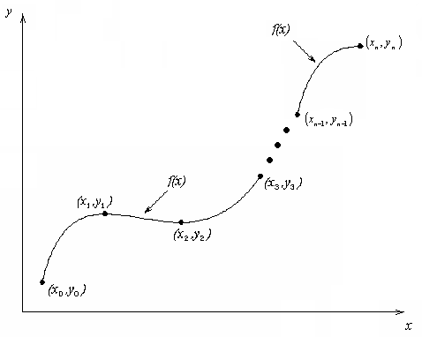
What is Interpolation ?
Given (x₀,y₀), (x₁,y₁), …… (x_{n},y_{n}), find the value of ‘y’ at a value of ‘x’ that is not given.

Slide 4
Interpolants
Polynomials are the most common choice of interpolants because they are easy to:
Evaluate
Differentiate, and
Integrate.

Slide 5
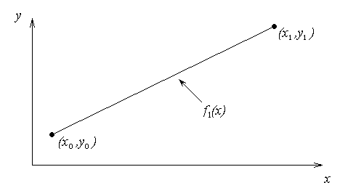
Newton’s Divided Difference Method
Linear interpolation: Given pass a linear interpolant through the data
Where
Here we don’t solve any linear system of equation as in the Direct Interpolation

Slide 6
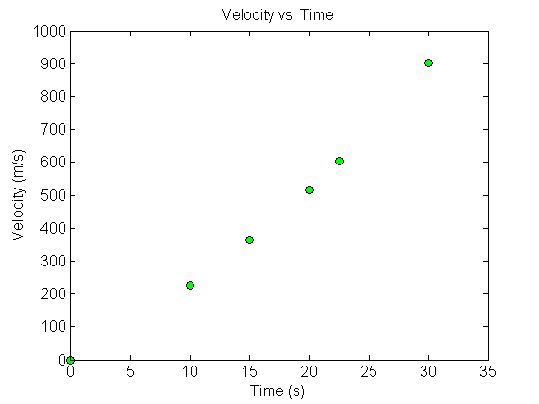
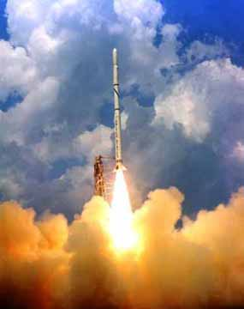
Example
The upward velocity of a rocket is given as a function of time in Table 1. Find the velocity at t=16 seconds using the Newton Divided Difference method for linear interpolation.
Table. Velocity as a
function of time
0 | 0
10 | 227.04
15 | 362.78
20 | 517.35
22.5 | 602.97
30 | 901.67
Figure. Velocity vs. time data
for the rocket example

Slide 7
Linear Interpolation

Slide 8
Linear Interpolation (contd)

Slide 9
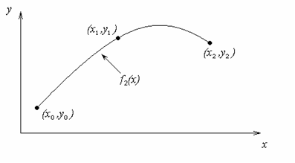
Quadratic Interpolation

Slide 10
Example
The upward velocity of a rocket is given as a function of time in Table 1. Find the velocity at t=16 seconds using the Newton Divided Difference method for quadratic interpolation.
Table. Velocity as a
function of time
0 | 0
10 | 227.04
15 | 362.78
20 | 517.35
22.5 | 602.97
30 | 901.67
Figure. Velocity vs. time data
for the rocket example

Slide 11
Quadratic Interpolation (contd)

Slide 12
Quadratic Interpolation (contd)

Slide 13
Quadratic Interpolation (contd)

Slide 14
General Form
where
Rewriting

Slide 15
General Form

Slide 16
General form

Slide 17
Example
The upward velocity of a rocket is given as a function of time in Table 1. Find the velocity at t=16 seconds using the Newton Divided Difference method for cubic interpolation.
Table. Velocity as a
function of time
0 | 0
10 | 227.04
15 | 362.78
20 | 517.35
22.5 | 602.97
30 | 901.67
Figure. Velocity vs. time data
for the rocket example

Slide 18
Example
The velocity profile is chosen as
we need to choose four data points that are closest to

Slide 19
Example

Slide 20
Example

Slide 21
Comparison Table

Slide 22
Distance from Velocity Profile
Find the distance covered by the rocket from t=11s to
t=16s ?

Slide 23
Acceleration from Velocity Profile
Find the acceleration of the rocket at t=16s given that

